Slide 1

MSE 593 Data-Driven Materials Design and Genomics
MSE 593
Data-Driven
Materials Design
and Genomics
Prof. Wenhao Sun, whsun@umich.edu, H.H. Dow 2001
Prof. Katsuyo Thornton, kthorn@umich.edu, Offices: H.H. Dow 2022
Notes:
Syllabus Wenhao Sun
Set up Canvas – Katsuyo
Google Survey – Katusyo

Slide 2
Enhancing reaction ΔH with metathesis
Solid-State Synthesis of MgCr₂S₄:
MgS + Cr₂S₃ → MgCr₂S₄
ΔH = -1 kJ/mol
>2 weeks
800 < T < 900 °C
Regrinding needed
Metathesis Reaction
2 NaCrS₂ + MgCl₂ → MgCr₂S₄ + 2 NaCl
ΔH = -46 kJ/mol
Na+Cl separated in the precursor
Reaction is thermodynamically driven
by Na⁺ + Cl⁻ → NaCl formation
Synthesis at 500 °C
In 30 minutes
With 100 nm nanoparticles

Slide 3
What does it mean for a material
to be stable?
Suppose I have Elements: A and B,
and Compounds: A₂B, AB, AB₂, A₃B₂
Convex Hull
A + B → AB
2A + B → A₂B
A₂B + B → AB
AB + B → AB₂
AB₂ + A → AB
3A + 2B → A₃B₂
…
…
…
_{Etc!}
A
A₂B
AB
AB₂
B
Energy
A₃B₂
Metastable
Stable

Slide 5
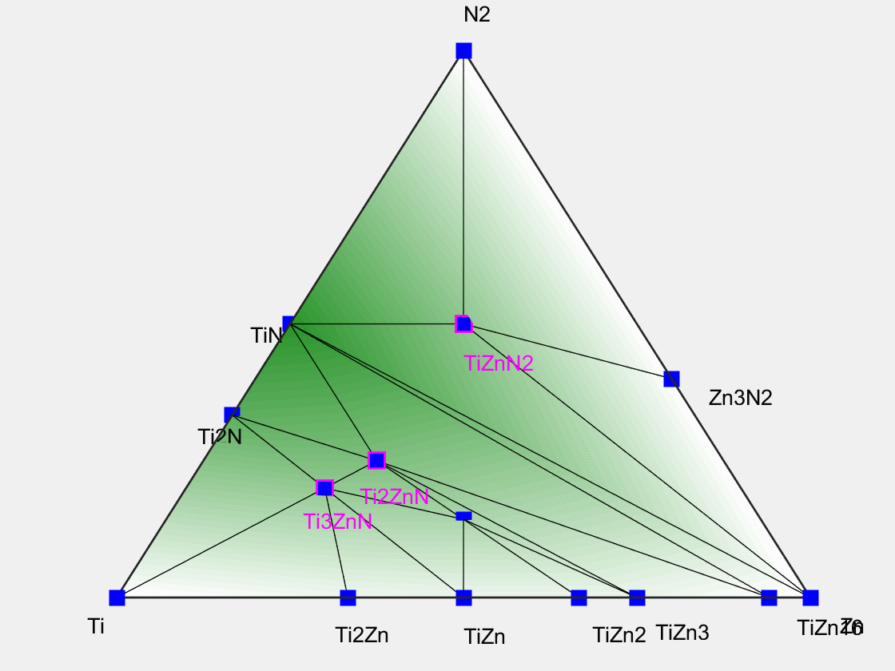

Slide 7
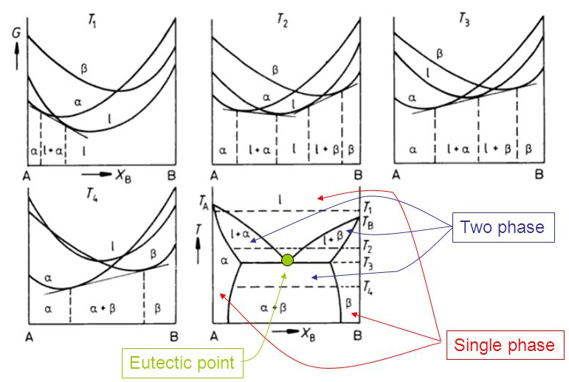
To get the high temperature part of the phase diagram, you need the vibrational
entropy of the phases (which is expensive), and the free-energy of the liquid
(which is complicated). So in DFT we usually only use T = 0K enthalpies.
Upper bound for TΔS ~ 1000K * 8.314 J/mol/K ~ 8 kJ/mol
Reaction energies are usually order ΔH ~ 100-1000 kJ/mol
So T=0K DFT actually gives you a lot of reasonable stability information.

Slide 8
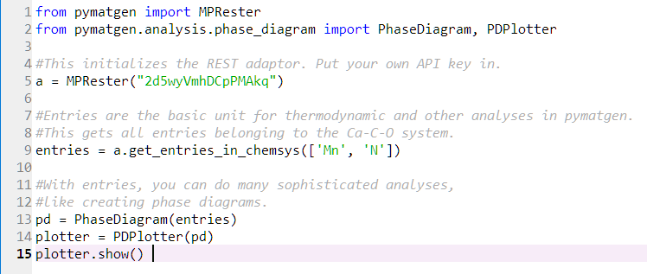
A
A₂B
AB
AB₂
B
Energy
A₃B₂
Metastable
Stable
MPRester(APIKey)
https://pymatgen.org/pymatgen.ext.matproj.html
Composition(‘MnN’)
https://pymatgen.org/pymatgen.core.composition.html
Entry(Composition, DFT energy)
https://pymatgen.org/pymatgen.entries.computed_entries.html
PhaseDiagram([List of entries])
Solves the convex hull
PDPlotter(PhaseDiagram Object)
Plots the Phase Diagram
https://pymatgen.org/pymatgen.analysis.phase_diagram.html

Slide 9
Object Oriented Programming
Bank Account
Properties
Person: Object
Account Balance: Float
Account type (Checking/Saving): String
Functions
Add Funds
Withdraw Funds
Check Balance
https://www.geeksforgeeks.org/python-program-to-create-bankaccount-class-with-deposit-withdraw-function/
Person
Properties
Name: String
Address: String
Birthday: Date
Social Security Number: String
Password: String
Etc.
Functions
Change Address
Change Password

Slide 10
How do you learn pymatgen?
Work on a real problem
(It is easier to search for and use something in pymatgen, rather of learning the whole thing at the outset.)
2. Look for what you need in the documentation
https://pymatgen.org/pymatgen.html#subpackages
It will give you some idea on how to get started.
3. Read the source code for the relevant method:
https://github.com/materialsproject/pymatgen

